Slide 1

Data Structures and Abstractions with Java™
5th Edition
Module 10 - Lists
Including:
Chapter 10 – Lists
Java Interlude 6 – Mutable and Immutable Objects
Chapter 11 – List Implementation that uses an array
Chapter 12 – List Implementation that used linked data
Chapter 17 – Sorted Lists
Chapter 18 – Inheritance and Lists

Slide 2

Lists
A way to organize data
Examples
To-do list
Gift lists
Grocery Lists
Items in list have position
May or may not be important
Items may be added anywhere
FIGURE 10-1 A to-do list

Slide 3
Specifications for the ADT List
add(newEntry)
add(newPosition, newEntry)
remove(givenPosition)
clear()
replace(givenPosition, newEntry)
getEntry(givenPosition)
toArray()
contains(anEntry)
getLength()
isEmpty()

Slide 4
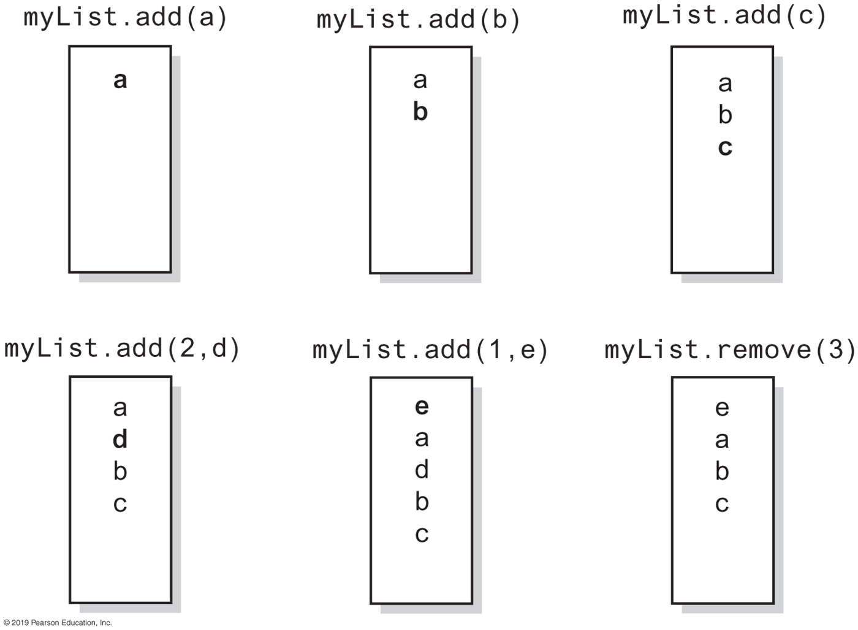
Specifications for the ADT List
FIGURE 10-2 The effect of ADT list operations on an initially empty list

Slide 5
Specifications for the ADT List
Data
A collection of objects in a specific order and having the same data type
The number of objects in the collection
Pseudocode | UML | Description
add(newEntry) | +add(newEntry: T): void | Task: Adds newEntry to the end of the list. Input: newEntry is an object. Output: None.
add(newPosition, anEntry) | +add(newPosition: integer, anEntry: T): void | Task: Adds newEntry at position newPosition within the list. Position 1 indicates the first entry in the list. Input: newPosition is an integer, newEntry is an object. Output: Throws an exception if newPosition is invalid for this list before the operation.
remove(givenPosition) | +remove(givenPosition: integer): T | Task: Removes and returns the entry at position givenPosition. Input: givenPosition is an integer. Output: Either returns the removed entry or throws an exception if givenPosition is invalid for this list. Note that any value of givenPosition is invalid if the list is empty before the operation.
clear() | +clear(): void | Task: Removes all entries from the list. Input: None. Output: None.
replace(givenPosition, anEntry) | +replace(givenPosition: integer, anEntry: T): T | Task: Replaces the entry at position givenPosition with newEntry. Input: givenPosition is an integer, newEntry is an object. Output: Either returns the replaced entry or throws an exception if givenPosition is invalid for this list. Note that any value of givenPosition is invalid if the list is empty before the operation.

Slide 6
Specifications for the ADT List
Data
A collection of objects in a specific order and having the same data type
The number of objects in the collection
Pseudocode | UML | Description
getEntry(givenPosition) | +getEntry(givenPosition: integer): T | Task: Retrieves the entry at position givenPosition. Input: givenPosition is an integer. Output: Either returns the entry at position givenPosition or throws an exception if givenPosition is invalid for this list. Note that any value of givenPosition is invalid if the list is empty before the operation.
toArray() | +toArray: T[ ] | Task: Retrieves all entries that are in the list in the order in which they occur. Input: None. Output: Returns a new array of the entries currently in the list.
contains(anEntry) | +contains(anEntry: T): boolean | Task: Sees whether the list contains anEntry. Input: anEntry is an object. Output: Returns true if anEntry is in the list, or false if not.
getLength() | +getLength(): integer | Task: Gets the number of entries currently in the list. Input: None. Output: Returns the number of entries currently in the list.
isEmpty() | +isEmpty(): boolean | Task: Sees whether the list is empty. Input: None. Output: Returns true if the list is empty, or false if not.

Slide 7
LISTING 10-1 The interface ListInterface (Part 1)
** An interface ADT list. Entries in a list have positions that begin with 1. */
public interface ListInterface<T> {
/** Adds a new entry to the end of this list.
Entries currently in the list are unaffected.
The list's size is increased by 1.
@param newEntry The object to be added as a new entry. */
public void add(T newEntry);
/** Adds a new entry at a specified position within this list.
Entries originally at and above the specified position
are at the next higher position within the list.
The list's size is increased by 1.
@param newPosition An integer that specifies the desired
position of the new entry.
@param newEntry The object to be added as a new entry.
@throws IndexOutOfBoundsException if either
newPosition < 1 or newPosition > getLength() + 1. */
public void add(int newPosition, T newEntry);
/** Removes the entry at a given position from this list.
Entries originally at positions higher than the given
position are at the next lower position within the list,
and the list's size is decreased by 1.
@param givenPosition An integer that indicates the position of
the entry to be removed.
@return A reference to the removed entry.
@throws IndexOutOfBoundsException if either
givenPosition < 1 or givenPosition > getLength(). */
public T remove(int givenPosition);

Slide 8
LISTING 10-1 The interface ListInterface (Part 2)
/** Removes all entries from this list. */
public void clear();
/** Replaces the entry at a given position in this list.
@param givenPosition An integer that indicates the position of
the entry to be replaced.
@param newEntry The object that will replace the entry at the
position givenPosition.
@return The original entry that was replaced.
@throws IndexOutOfBoundsException if either
givenPosition < 1 or givenPosition > getLength(). */
public T replace(int givenPosition, T newEntry);
/** Retrieves the entry at a given position in this list.
@param givenPosition An integer that indicates the position of
the desired entry.
@return A reference to the indicated entry.
@throws IndexOutOfBoundsException if either
givenPosition < 1 or givenPosition > getLength(). */
public T getEntry(int givenPosition);
/** Retrieves all entries that are in this list in the order in which
they occur in the list.
@return A newly allocated array of all the entries in the list.
If the list is empty, the returned array is empty. */
public T[] toArray();
/** Sees whether this list contains a given entry.
@param anEntry The object that is the desired entry.
@return True if the list contains anEntry, or false if not. */
public boolean contains(T anEntry);

Slide 9
LISTING 10-1 The interface ListInterface (Part 3)
/** Gets the length of this list.
@return The integer number of entries currently in the list. */
public int getLength();
/** Sees whether this list is empty.
@return True if the list is empty, or false if not. */
public boolean isEmpty();
} // end ListInterface

Slide 10
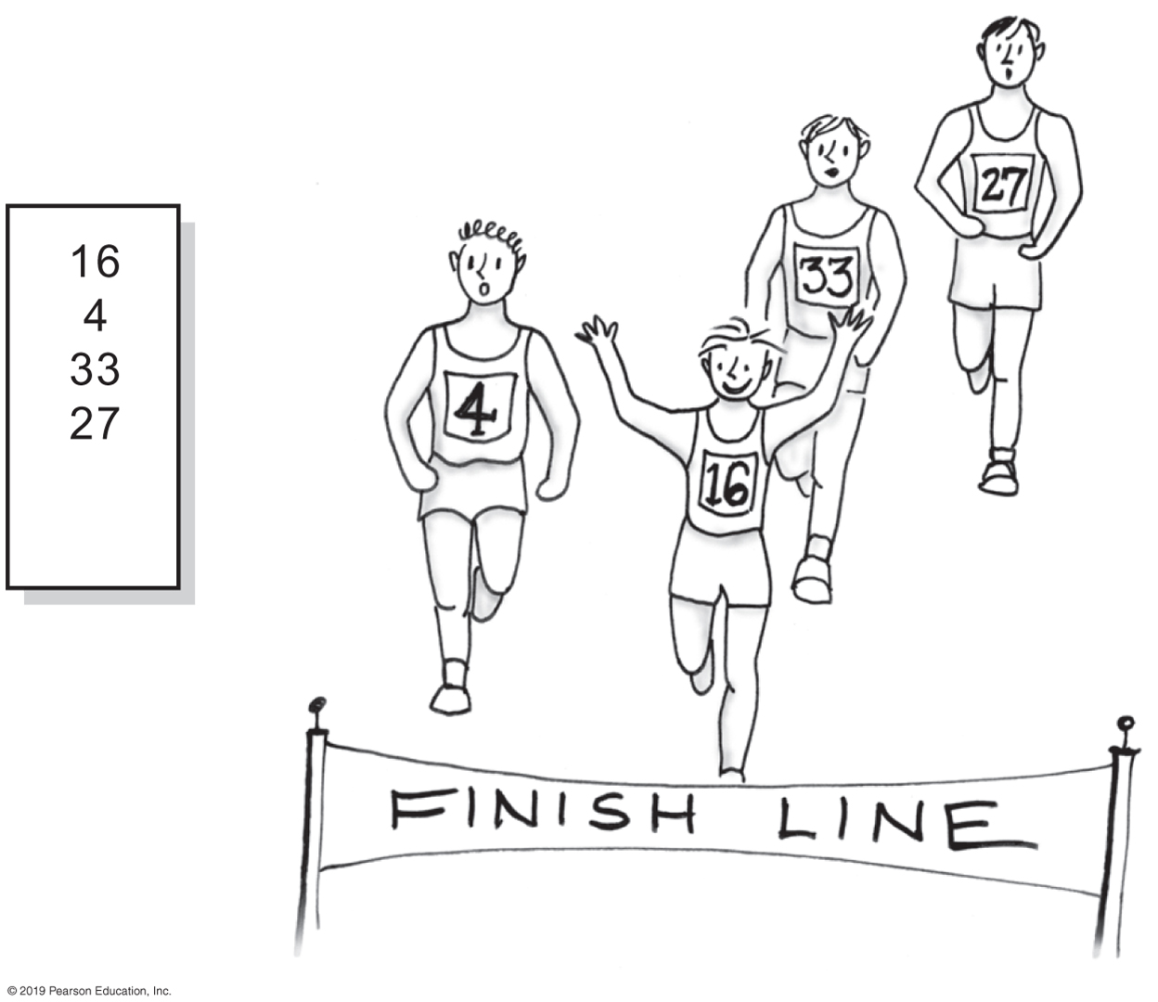
Using the ADT List
FIGURE 10-3 A list of numbers that identify runners in the order in which they finished

Slide 11
Using the ADT List
/** A driver that uses a list to track the
runners in a race as they cross the finish line. */
public class RoadRace {
public static void main(String[] args) {
recordWinners();
} // end main
public static void recordWinners() {
ListInterface<String> runnerList = new AList<>();
// runnerList has only methods in ListInterface
runnerList.add("16"); // Winner
runnerList.add(" 4"); // Second place
runnerList.add("33"); // Third place
runnerList.add("27"); // Fourth place
displayList(runnerList);
} // end recordWinners
public static void displayList(ListInterface<String> list) {
int numberOfEntries = list.getLength();
System.out.println("The list contains " + numberOfEntries +
" entries, as follows:");
for (int position = 1; position <= numberOfEntries; position++)
System.out.println(list.getEntry(position) +
" is entry " + position);
System.out.println();
} // end displayList
} // end RoadRace
Program Output
The list contains 4 entries,
as follows:
16 is entry 1
4 is entry 2
33 is entry 3
27 is entry 4
LISTING 10-2 A client of a class that implements ListInterface

Slide 12
Using the ADT List
// Make an alphabetical list of names as students enter a room
ListInterface<String> alphaList = new AList<>();
alphaList.add(1, "Amy"); // Amy
alphaList.add(2, "Elias"); // Amy Elias
alphaList.add(2, "Bob"); // Amy Bob Elias
alphaList.add(3, "Drew"); // Amy Bob Drew Elias
alphaList.add(1, "Aaron"); // Aaron Amy Bob Drew Elias
alphaList.add(4, "Carol"); // Aaron Amy Bob Carol Drew Elias
Example

Slide 13
Using the ADT List
// Make a list of names as you think of them
ListInterface<Name> nameList = new AList<>();
Name amy = new Name("Amy", "Smith");
nameList.add(amy);
nameList.add(new Name("Tina", "Drexel");
nameList.add(new Name("Robert", "Jones");
Name secondName = nameList.getEntry(2);
A list of Name objects, rather than String

Slide 14
Java Class Library: The Interface List
public void add(int index, T newEntry)
public T remove(int index)
public void clear()
public T set(int index, T anEntry) // Like replace
public T get(int index) // Like getEntry
public boolean contains(Object anEntry)
public int size() // Like getLength
public boolean isEmpty()
Method headers from the interface List

Slide 15
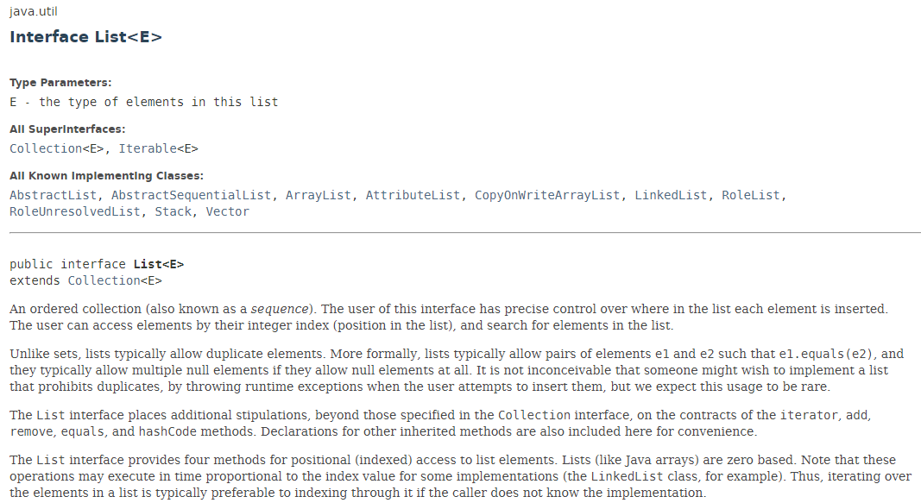
Java Class Library: The Interface List

Slide 16
Java Class Library: The Class ArrayList
Available constructors
public ArrayList()
public ArrayList(int initialCapacity)
Similar to java.util.vector
Can use either ArrayList or Vector as an implementation of the interface List.

Slide 17
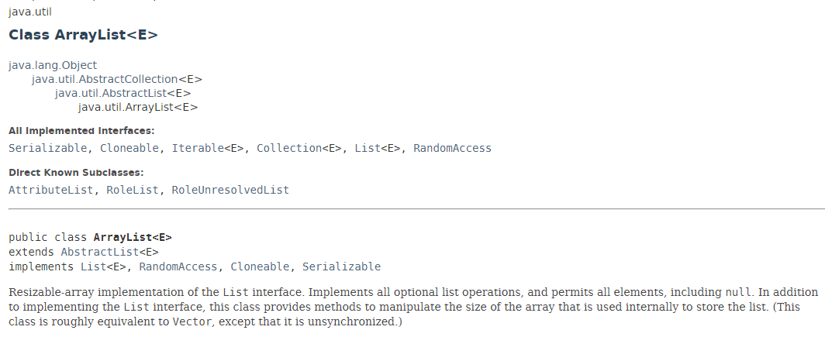
Java Class Library: The Class ArrayList

Slide 18
Mutable Objects
Consider classes studied that have private data fields and public methods that either look at or change these fields
Such methods called accessor methods and mutator methods
An object that belongs to a class that has public mutator methods said to be mutable

Slide 19

Mutable Objects
FIGURE J6-1 An object and its reference variable chris

Slide 20
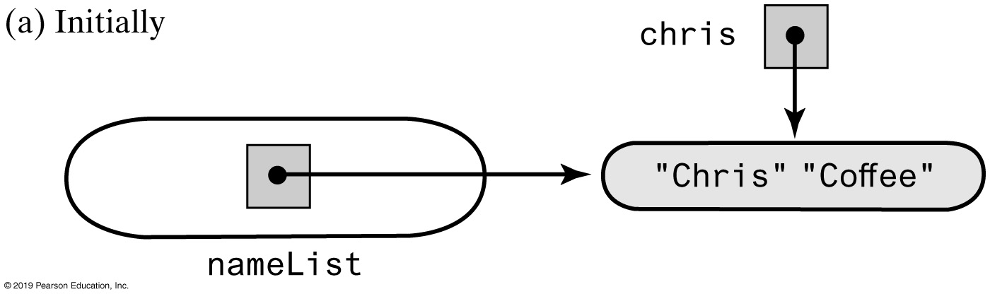
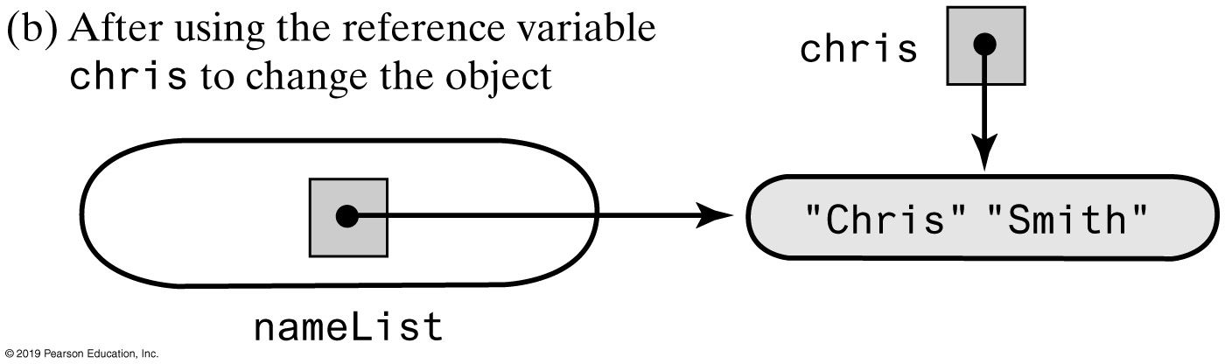
Mutable Objects
FIGURE J6-2 An object in the list nameList before and after the object is changed

Slide 21
FIGURE J6-3 The classes Name and ImmutableName
Name
first last
getFirst() getLast() getName() setFirst(firstName) setLast(lastName) setName(firstName, lastName) giveLastNameTo(aName) toString() getImmutable()
ImmutableName
first last
getFirst() getLast() getName() toString() getMutable()

Slide 22

Using an Array to Implement the ADT List
FIGURE 11-1 A classroom that contains desks in fixed positions

Slide 23

Using an Array to Implement the ADT List
FIGURE 11-2 Seating a new student between two existing students: At least one other student must move

Slide 24
Using an Array to Implement the ADT List
AList
–list: T[] –numberOfEntries: integer –DEFAULT_CAPACITY: integer –MAX_CAPACITY: integer –integrityOK: boolean
+add(newEntry: T): void +add(givenPosition: integer, newEntry: T): void +remove(givenPosition: integer): T +clear(): void +replace(givenPosition: integer, newEntry: T): T +getEntry(givenPosition: integer): T +toArray(): T[] +contains(anEntry: T): boolean +getLength(): integer +isEmpty(): boolean
FIGURE 11-3 UML notation for the class AList

Slide 25
An Array List Implementation (Part 1)
/**
A class that implements a list of objects by using an array.
Entries in a list have positions that begin with 1.
Duplicate entries are allowed. */
public class AList<T> implements ListInterface<T>
{
private T[] list; // Array of list entries; ignore list[0]
private int numberOfEntries;
private boolean integrityOK;
private static final int DEFAULT_CAPACITY = 25;
private static final int MAX_CAPACITY = 10000;
public AList()
{
this(DEFAULT_CAPACITY);
} // end default constructor
LISTING 11-1 The class AList

Slide 26
An Array List Implementation (Part 2)
public AList(int initialCapacity)
{
integrityOK = false;
// Is initialCapacity too small?
if (initialCapacity < DEFAULT_CAPACITY)
initialCapacity = DEFAULT_CAPACITY;
else // Is initialCapacity too big?
checkCapacity(initialCapacity);
// The cast is safe because the new array contains null entries
@SuppressWarnings("unchecked")
T[] tempList = (T[])new Object[initialCapacity + 1];
list = tempList;
numberOfEntries = 0;
integrityOK = true;
} // end constructor
public void add(T newEntry)
{
checkIntegrity();
list[numberOfEntries + 1] = newEntry;
numberOfEntries++;
ensureCapacity();
// add(numberOfEntries + 1, newEntry); // ALTERNATE CODE
} // end add
LISTING 1-1 The class AList

Slide 27
An Array List Implementation (Part 3)
public void add(int newPosition, T newEntry)
{ /* < Implementation deferred > */
} // end add
public T remove(int givenPosition)
{ /* < Implementation deferred > */
} // end remove
public void clear()
{ /* < Implementation deferred > */
} // end clear
public T replace(int givenPosition, T newEntry)
{ /* < Implementation deferred > */
} // end replace
public T getEntry(int givenPosition)
{ /* < Implementation deferred > */
} // end getEntry
LISTING 1-1 The class AList

Slide 28
An Array List Implementation (Part 4)
public T[] toArray()
{
checkIntegrity();
// The cast is safe because the new array contains null entries
@SuppressWarnings("unchecked")
T[] result = (T[])new Object[numberOfEntries]; // Unchecked cast
for (int index = 0; index < numberOfEntries; index++)
{
result[index] = list[index + 1];
} // end for
return result;
} // end toArray
public boolean contains(T anEntry)
{ /* < Implementation deferred > */
} // end contains
public int getLength()
{
return numberOfEntries;
} // end getLength
LISTING 11-1 The class AList

Slide 29
An Array List Implementation (Part 5)
public int getLength()
{
return numberOfEntries;
} // end getLength
public boolean isEmpty()
{
return numberOfEntries == 0; // Or getLength() == 0
} // end isEmpty
// Doubles the capacity of the array list if it is full.
// Precondition: checkIntegrity has been called.
private void ensureCapacity()
{
int capacity = list.length - 1;
if (numberOfEntries >= capacity)
{
int newCapacity = 2 * capacity;
checkCapacity(newCapacity); // Is capacity too big?
list = Arrays.copyOf(list, newCapacity + 1);
} // end if
} // end ensureCapacity
LISTING 1-1 The class AList

Slide 30
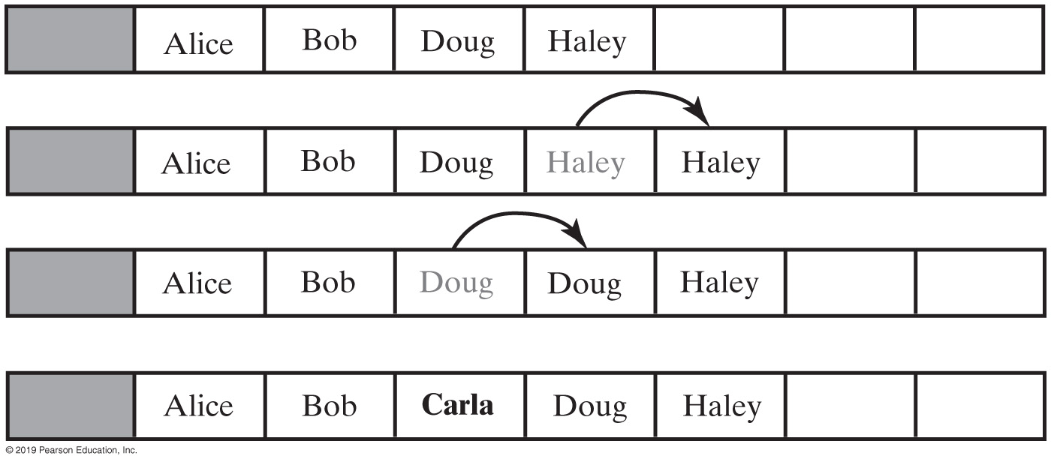
Using an Array to Implement the ADT List
FIGURE 11-4 Making room to insert Carla as the third entry in an array

Slide 31
Using an Array to Implement the ADT List
// Precondition: The array list has room for another entry.
public void add(int newPosition, T newEntry)
{
checkIntegrity();
// Assertion: The array list has room for another entry.
if ((newPosition >= 1) && (newPosition <= numberOfEntries + 1))
{
if (newPosition <= numberOfEntries)
makeRoom(newPosition);
list[newPosition] = newEntry;
numberOfEntries++;
ensureCapacity(); // Ensure enough room for next add
}
else
throw new IndexOutOfBoundsException(
"Given position of add's new entry is out of bounds.");
} // end add
Implementing add at a specific position

Slide 32
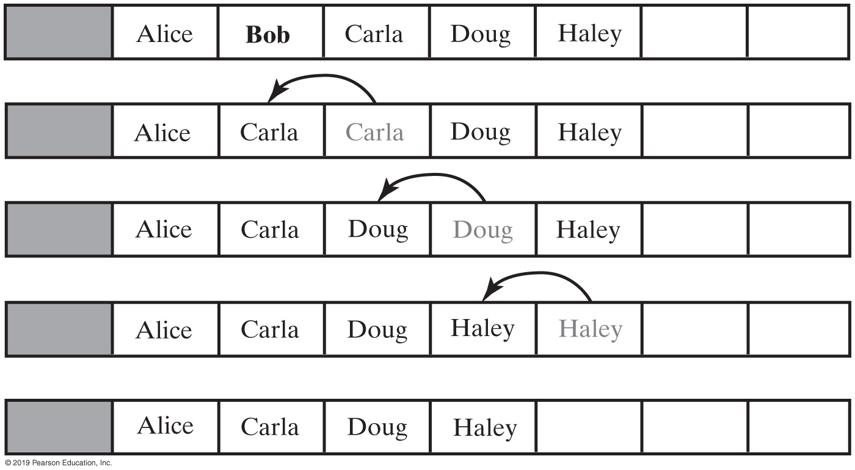
Using an Array to Implement the ADT List
FIGURE 11-5 Removing Bob by shifting array entries

Slide 33
Using an Array to Implement the ADT List
public T remove(int givenPosition)
{
checkIntegrity();
if ((givenPosition >= 1) && (givenPosition <= numberOfEntries))
{
// Assertion: The list is not empty
T result = list[givenPosition]; // Get entry to be removed
// Move subsequent entries towards entry to be removed,
// unless it is last in list
if (givenPosition < numberOfEntries)
removeGap(givenPosition);
list[numberOfEntries] = null;
numberOfEntries--;
return result; // Return reference to removed entry
}
else
throw new IndexOutOfBoundsException(
"Illegal position given to remove operation.");
} // end remove
Implementation uses a private method removeGap to handle the details of moving data within the array.

Slide 34
Using an Array to Implement the ADT List
// Shifts entries that are beyond the entry to be removed to the
// next lower position.
// Precondition: 1 <= givenPosition < numberOfEntries;
// numberOfEntries is list's length before removal;
// checkIntegrity has been called.
private void removeGap(int givenPosition)
{
int removedIndex = givenPosition;
for (int index = removedIndex; index < numberOfEntries; index++)
list[index] = list[index + 1];
} // end removeGap
Method removeGap shifts list entries within the array

Slide 35
Using an Array to Implement the ADT List
public boolean contains(T anEntry)
{
checkIntegrity();
boolean found = false;
int index = 1;
while (!found && (index <= numberOfEntries))
{
if (anEntry.equals(list[index]))
found = true;
index++;
} // end while
return found;
} // end contains
Method contains uses a local boolean variable to terminate the loop when we find the desired entry.

Slide 36
Using an Array to Implement the ADT List
public void add(T newEntry)
{
checkIntegrity();
list[numberOfEntries + 1] = newEntry;
numberOfEntries++;
ensureCapacity();
} // end add
Operation that adds a new entry to the end of a list. Efficiency O(1) if new if array is not resized.

Slide 37
Using an Array to Implement the ADT List
public void add(int givenPosition, T newEntry)
{
checkIntegrity();
if ((givenPosition >= 1) && (givenPosition <= numberOfEntries + 1))
{
if (givenPosition <= numberOfEntries)
makeRoom(givenPosition);
list[givenPosition] = newEntry;
numberOfEntries++;
ensureCapacity(); // Ensure enough room for next add
}
else
throw new IndexOutOfBoundsException(
"Given position of add's new entry is out of bounds.");
} // end add
Add a new entry to a list at a client-specified position.

Slide 38
Using an Array to Implement the ADT List
private void makeRoom(int givenPosition)
{
int newIndex = givenPosition;
int lastIndex = numberOfEntries;
for (int index = lastIndex; index >= newIndex; index--)
list[index + 1] = list[index];
} // end makeRoom
Method add uses method makeRoom.

Slide 39
Advantages of Linked Implementation
Uses memory only as needed
When entry removed, unneeded memory returned to system
Avoids moving data when adding or removing entries

Slide 40
Adding a Node at Various Positions
Possible cases:
Chain is empty
Adding node at chain’s beginning
Adding node between adjacent nodes
Adding node to chain’s end

Slide 41
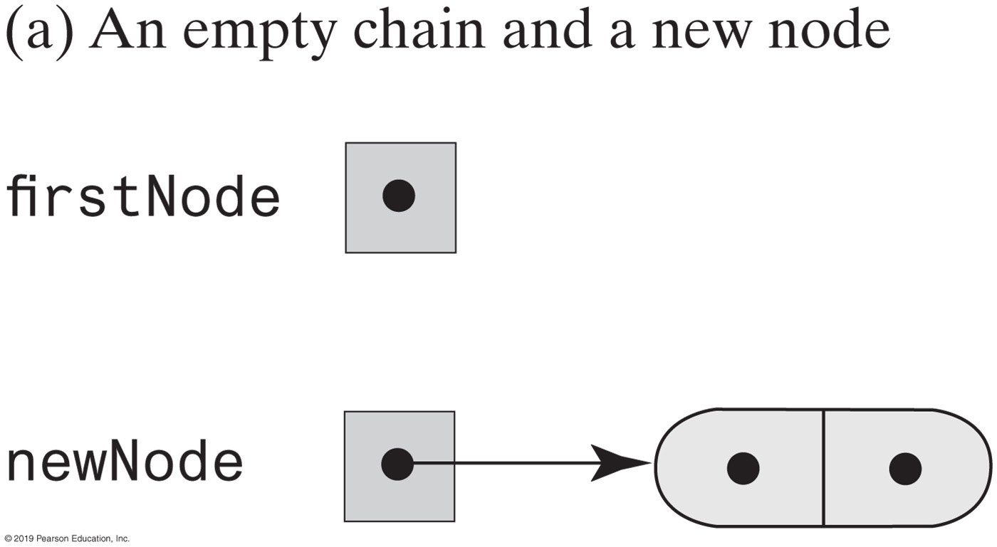
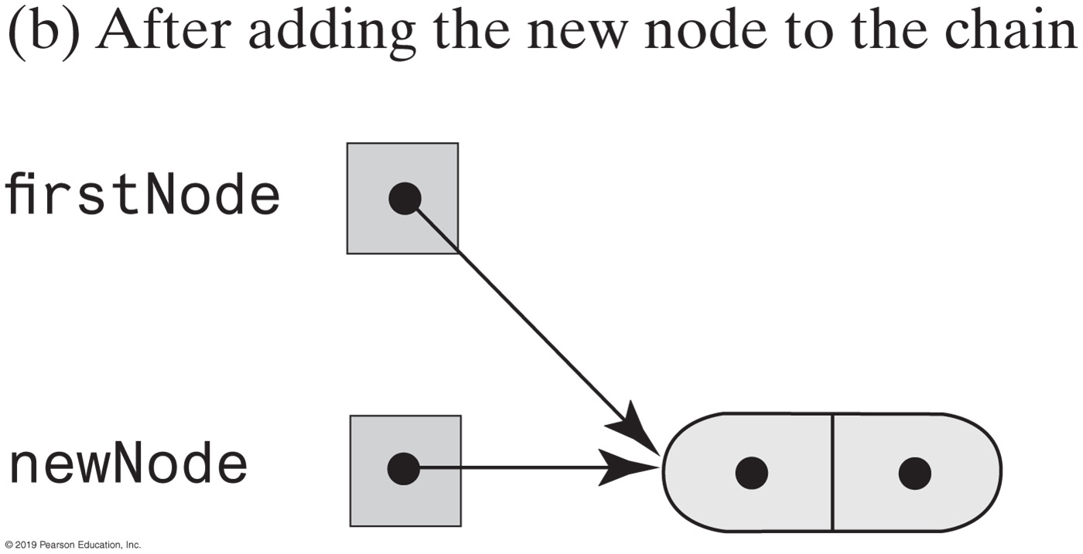
Adding a Node
This pseudocode establishes a new node for the given data
newNode references a new instance of Node
Place newEntry in newNode
firstNode = address of newNode
FIGURE 12-1 Adding a node to an empty chain

Slide 42
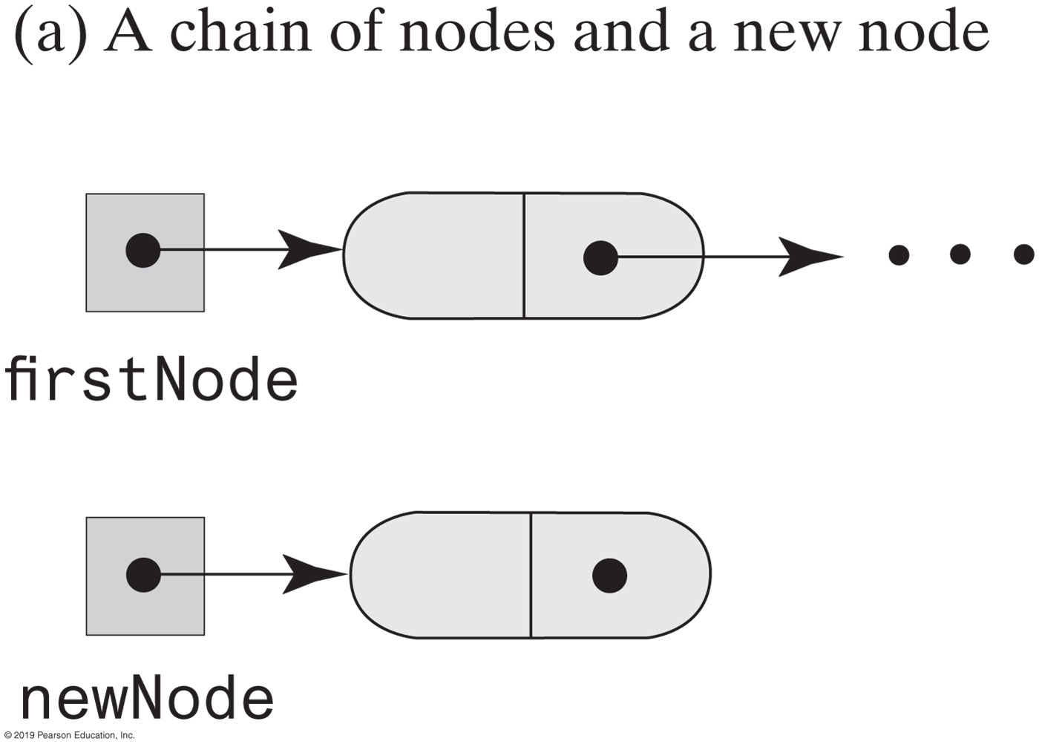
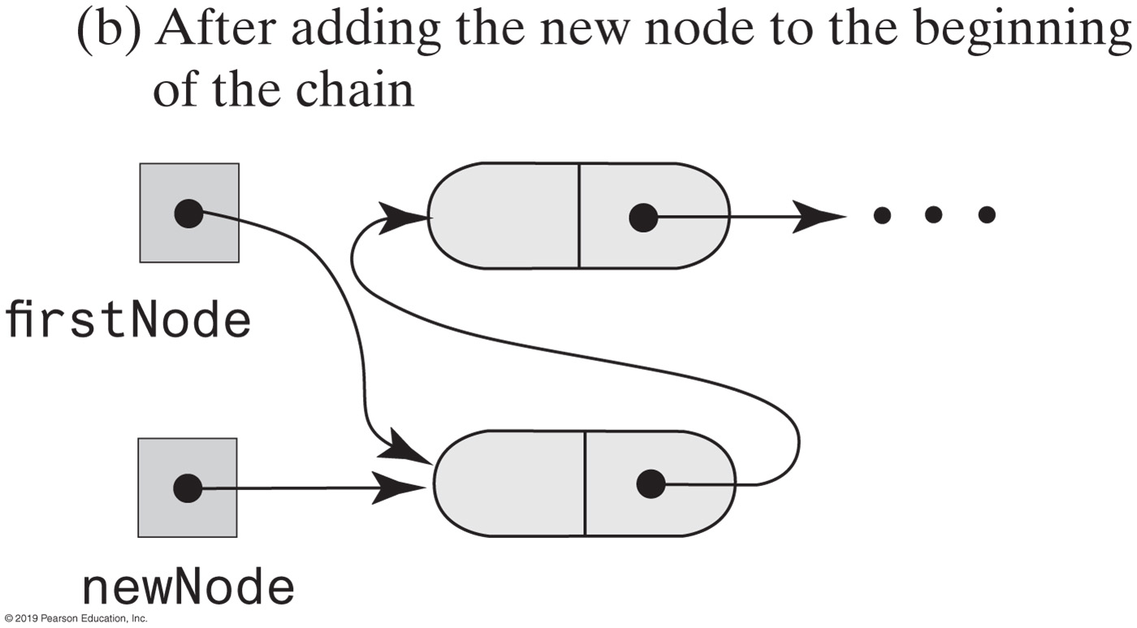
Adding a Node
This pseudocode describes the steps needed to add a node to the beginning of a chain.
newNode references a new instance of Node
Place newEntry in newNode
Set newNode’s link to firstNode
Set firstNode to newNode
FIGURE 12-2 Adding a node to the beginning of a chain

Slide 43
Adding a Node
Pseudocode to add a node to a chain between two existing, consecutive nodes
newNode references the new node
Place newEntry in newNode
Let nodeBefore reference the node that will be before the new node
Set nodeAfter to nodeBefore’s link
Set newNode’s link to nodeAfter
Set nodeBefore’s link to newNode

Slide 44
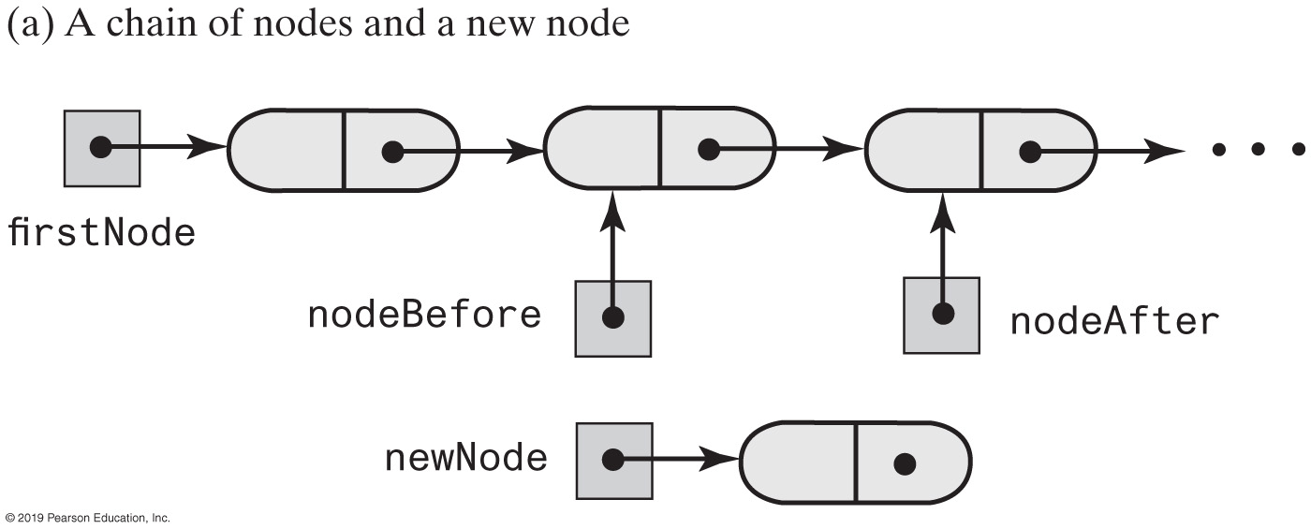
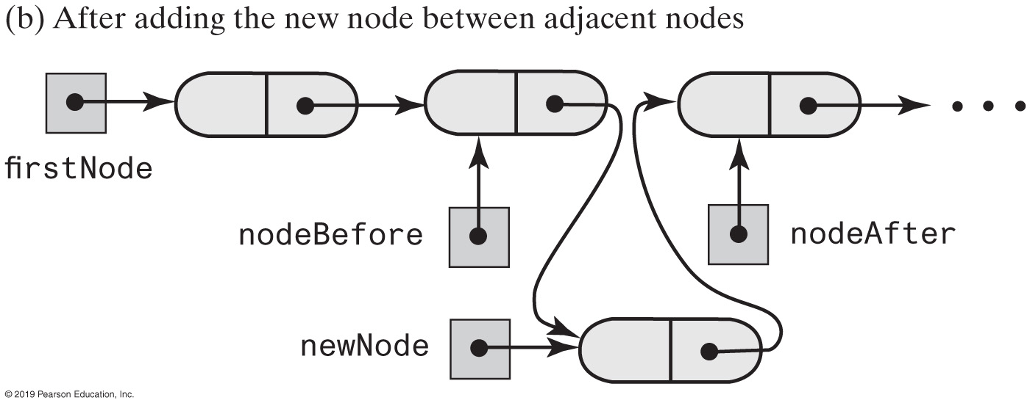
Adding a Node
FIGURE 12-3 Adding a node between two adjacent nodes

Slide 45
Adding a Node
Steps to add a node at the end of a chain.
newNode references a new instance of Node
Place newEntry in newNode
Locate the last node in the chain
Place the address of newNode in this last node

Slide 46
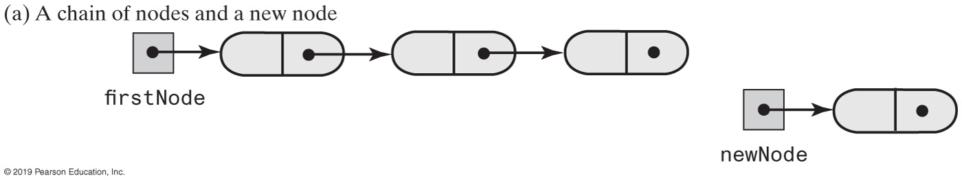
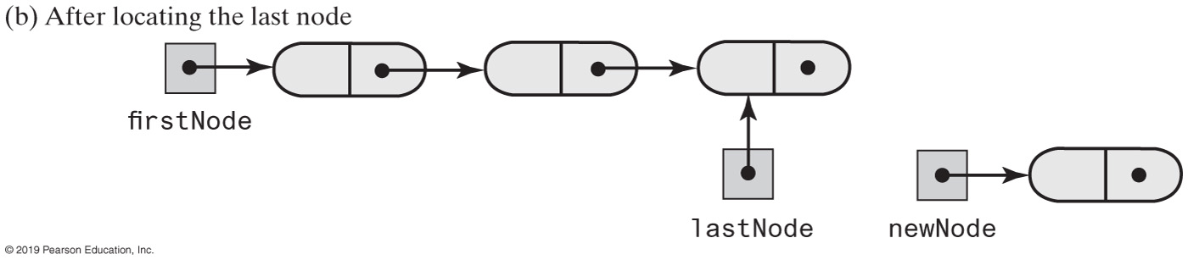
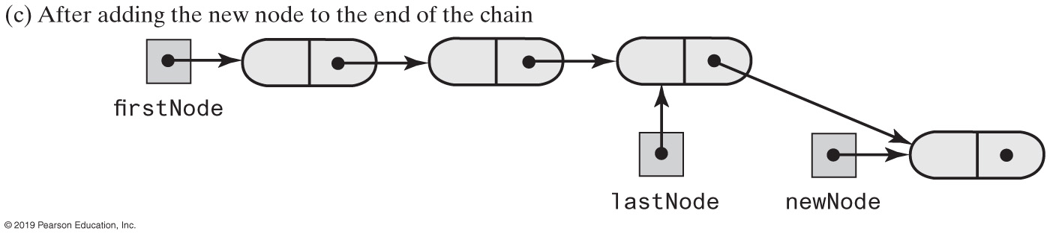
Adding a Node
FIGURE 12-4 Adding a node to the end of a chain

Slide 47
Removing a Node
Possible cases
Removing the first node
Removing a node other than first one

Slide 48
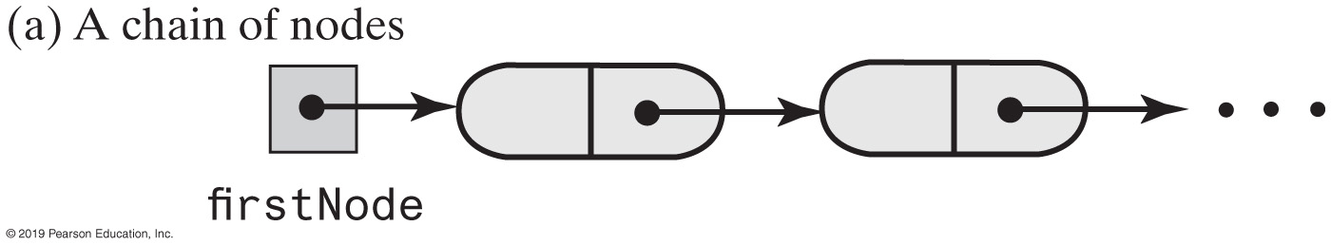
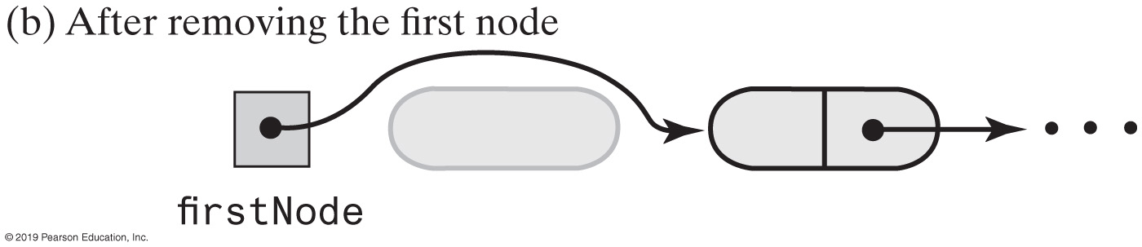
Removing a Node
Steps for removing the first node.
Set firstNode to the link in the first node; firstNode now either references the second node or is null if the chain had only one node.
Since all references to the first node no longer exist, the system automatically recycles the first node’s memory.
FIGURE 12-5 Removing the first node from a chain

Slide 49
Removing a Node
Removing a node other than the first one.
Let nodeBefore reference the node before the one to be removed.
Set nodeToRemove to nodeBefore’s link; nodeToRemove now references the node to be removed.
Set nodeAfter to nodeToRemove’s link; nodeAfter now either references the node after the one to be removed or is null.
Set nodeBefore’s link to nodeAfter. (nodeToRemove is now disconnected from the chain.)
Set nodeToRemove to null.
Since all references to the disconnected node no longer exist, the system automatically recycles the node’s memory.

Slide 50
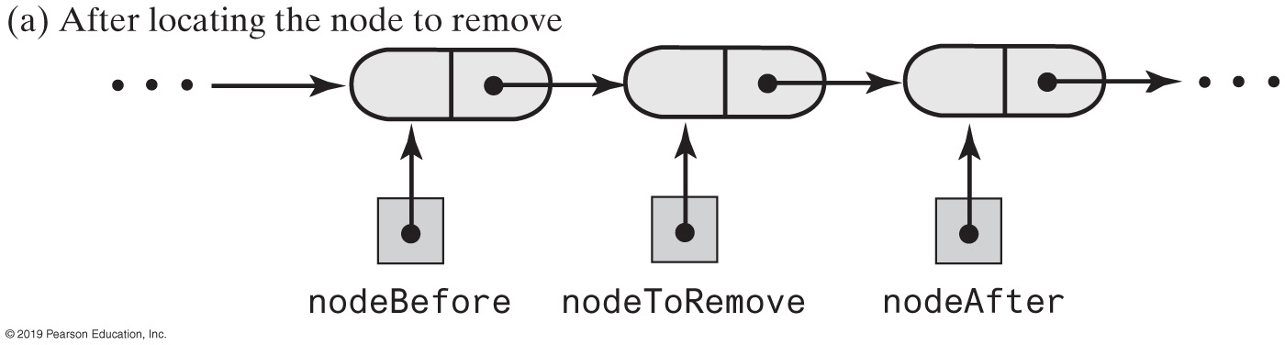
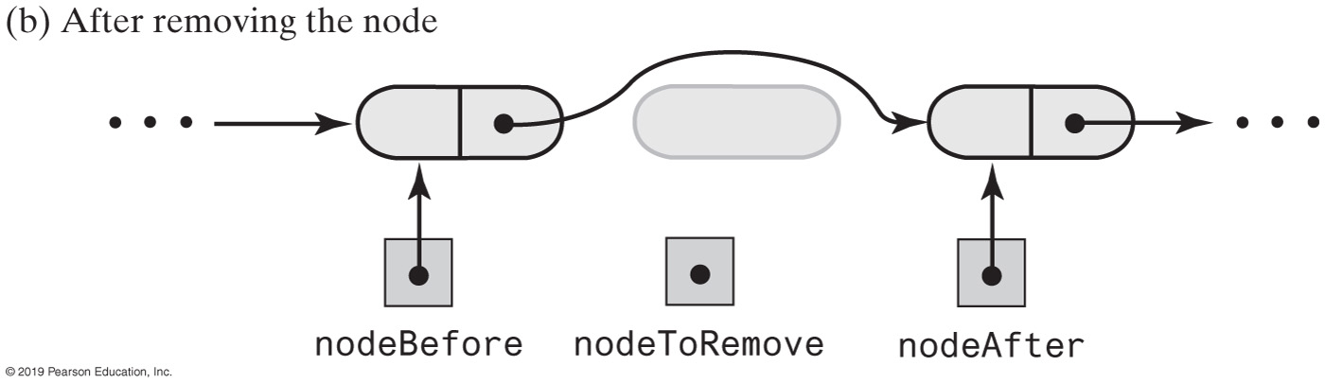
Removing a Node
FIGURE 12-6 Removing an interior node from a chain

Slide 51
Removing a Node
// Returns a reference to the node at a given position.
// Precondition: The chain is not empty;
// 1 <= givenPosition <= numberOfEntries.
private Node getNodeAt(int givenPosition)
{
// Assertion: (firstNode != null) &&
// (1 <= givenPosition) && (givenPosition <= numberOfEntries)
Node currentNode = firstNode;
// Traverse the chain to locate the desired node
// (skipped if givenPosition is 1)
for (int counter = 1; counter < givenPosition; counter++)
currentNode = currentNode.getNextNode();
// Assertion: currentNode != null
return currentNode;
} // end getNodeAt
Operations on a chain depended on the method getNodeAt

Slide 52

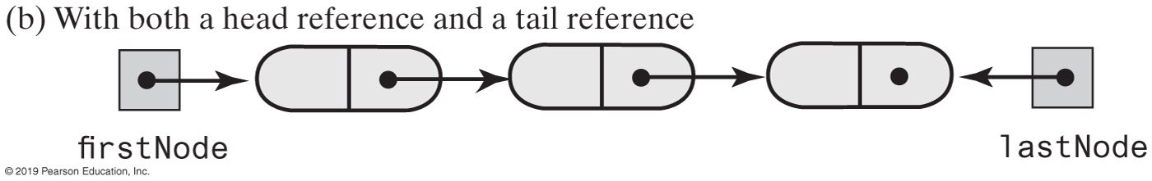
Using a Tail Reference
FIGURE 12-7 Two linked chains

Slide 53
Data Fields and Constructor (Part 1)
/** A linked implemention of the ADT list. */
public class LList<T> implements ListInterface<T>
{
private Node firstNode; // Reference to first node of chain
private int numberOfEntries;
public LList()
{
initializeDataFields();
} // end default constructor
public void clear()
{
initializeDataFields();
} // end clear
/* < Implementations of the public methods add, remove, replace, getEntry, contains,
getLength, isEmpty, and toArray go here. >
. . . */
// Initializes the class's data fields to indicate an empty list.
private void initializeDataFields()
{
firstNode = null;
numberOfEntries = 0;
} // end initializeDataFields
LISTING 12-1 An outline of the class LList

Slide 54
Data Fields and Constructor (Part 2)
// Returns a reference to the node at a given position.
// Precondition: The chain is not empty;
// 1 <= givenPosition <= numberOfEntries.
private Node getNodeAt(int givenPosition)
{
// Assertion: (firstNode != null) &&
// (1 <= givenPosition) && (givenPosition <= numberOfEntries)
Node currentNode = firstNode;
// Traverse the chain to locate the desired node
// (skipped if givenPosition is 1)
for (int counter = 1; counter < givenPosition; counter++)
currentNode = currentNode.getNextNode();
// Assertion: currentNode != null
return currentNode;
} // end getNodeAt
private class Node
{
// < Implementation of private inner class Node >
} // end Node
} // end LList
LISTING 12-1 An outline of the class LList

Slide 55
Adding to the End of the List
public void add(T newEntry)
{
Node newNode = new Node(newEntry);
if (isEmpty())
firstNode = newNode;
else // Add to end of nonempty list
{
Node lastNode = getNodeAt(numberOfEntries);
lastNode.setNextNode(newNode); // Make last node reference new node
} // end if
numberOfEntries++;
} // end add
The method add assumes method getNodeAt

Slide 56
Adding at a Given Position
public void add(int givenPosition, T newEntry)
{
if ((givenPosition >= 1) && (givenPosition <= numberOfEntries + 1))
{
Node newNode = new Node(newEntry);
if (givenPosition == 1) // Case 1
{
newNode.setNextNode(firstNode);
firstNode = newNode;
}
else // Case 2: list is not empty
{ // and givenPosition > 1
Node nodeBefore = getNodeAt(givenPosition - 1);
Node nodeAfter = nodeBefore.getNextNode();
newNode.setNextNode(nodeAfter);
nodeBefore.setNextNode(newNode);
} // end if
numberOfEntries++;
}
else
throw new IndexOutOfBoundsException(
"Illegal position given to add operation.");
} // end add
add method.

Slide 57
Method isEmpty
public boolean isEmpty()
{
boolean result;
if (numberOfEntries == 0) // Or getLength() == 0
{
// Assertion: firstNode == null
result = true;
}
else
{
// Assertion: firstNode != null
result = false;
} // end if
return result;
} // end isEmpty

Slide 58
Method toArray
public T[] toArray()
{
// The cast is safe because the new array contains null entries
@SuppressWarnings("unchecked")
T[] result = (T[])new Object[numberOfEntries];
int index = 0;
Node currentNode = firstNode;
while ((index < numberOfEntries) && (currentNode != null))
{
result[index] = currentNode.getData();
currentNode = currentNode.getNextNode();
index++;
} // end while
return result;
} // end toArray
Traverses chain, loads an array.

Slide 59
Testing Core Methods
public static void main(String[] args)
{
System.out.println("Create an empty list.");
ListInterface<String> myList = new LList<String>();
System.out.println("List should be empty; isEmpty returns " +
myList.isEmpty() + ".");
System.out.println("\nTesting add to end:");
myList.add("15");
myList.add("25");
myList.add("35");
myList.add("45");
System.out.println("List should contain 15 25 35 45.");
displayList(myList);
System.out.println("List should not be empty; isEmpty() returns " +
myList.isEmpty() + ".");
System.out.println("\nTesting clear():");
myList.clear();
System.out.println("List should be empty; isEmpty returns " +
myList.isEmpty() + ".");
} // end main
LISTING 12-2 A main method that tests part of the implementation of the ADT list

Slide 60
Testing Core Methods
Program Output
Create an empty list.
List should be empty; isEmpty returns true.
Testing add to end:
List should contain 15 25 35 45.
The list contains 4 entries, as follows:
15 25 35 45
List should not be empty; isEmpty() returns false.
Testing clear():
List should be empty; isEmpty returns true.
LISTING 12-2 A main method that tests part of the implementation of the ADT list

Slide 61
remove method returns entry it deletes from list
public T remove(int givenPosition)
{
T result = null; // Return value
if ((givenPosition >= 1) && (givenPosition <= numberOfEntries))
{
// Assertion: !isEmpty()
if (givenPosition == 1) // Case 1: Remove first entry
{
result = firstNode.getData(); // Save entry to be removed
firstNode = firstNode.getNextNode(); // Remove entry
}
else // Case 2: Not first entry
{
Node nodeBefore = getNodeAt(givenPosition - 1);
Node nodeToRemove = nodeBefore.getNextNode();
result = nodeToRemove.getData(); // Save entry to be removed
Node nodeAfter = nodeToRemove.getNextNode();
nodeBefore.setNextNode(nodeAfter); // Remove entry
} // end if
numberOfEntries--; // Update count
return result; // Return removed entry
}
else
throw new IndexOutOfBoundsException(
"Illegal position given to remove operation.");
} // end remove

Slide 62
Continuing the Implementation
public T replace(int givenPosition, T newEntry)
{
if ((givenPosition >= 1) && (givenPosition <= numberOfEntries))
{
// Assertion: !isEmpty()
Node desiredNode = getNodeAt(givenPosition);
T originalEntry = desiredNode.getData();
desiredNode.setData(newEntry);
return originalEntry;
}
else
throw new IndexOutOfBoundsException(
"Illegal position given to replace operation.");
} // end replace
Replacing a list entry requires us to replace the data portion of a node with other data.

Slide 63
Continuing the Implementation
public T getEntry(int givenPosition)
{
if ((givenPosition >= 1) && (givenPosition <= numberOfEntries))
{
// Assertion: !isEmpty()
return getNodeAt(givenPosition).getData();
}
else
throw new IndexOutOfBoundsException(
"Illegal position given to getEntry operation.");
} // end getEntry
Retrieving a list entry is straightforward.

Slide 64
Continuing the Implementation
public boolean contains(T anEntry)
{
boolean found = false;
Node currentNode = firstNode;
while (!found && (currentNode != null))
{
if (anEntry.equals(currentNode.getData()))
found = true;
else
currentNode = currentNode.getNextNode();
} // end while
return found;
} // end contains
Checking to see if an entry is in the list, the method contains.

Slide 65
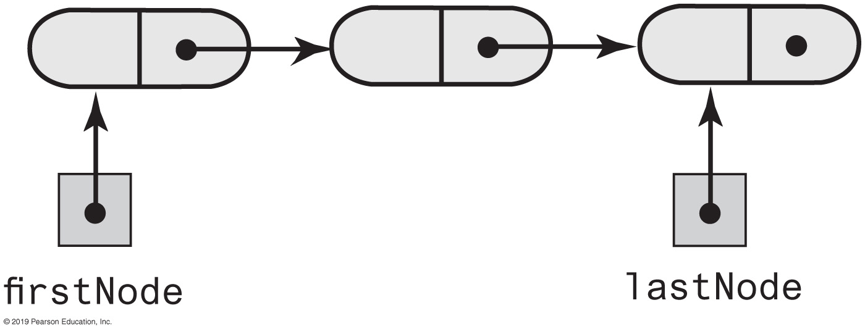
A Refined Linked Implementation
private Node firstNode; // Head reference to first node
private Node lastNode; // Tail reference to last node
private int numberOfEntries; // Number of entries in list
FIGURE 12-8 A linked chain with both a head reference and a tail reference

Slide 66
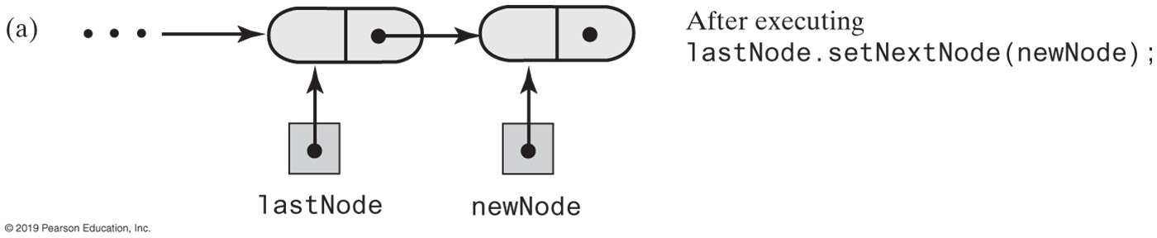
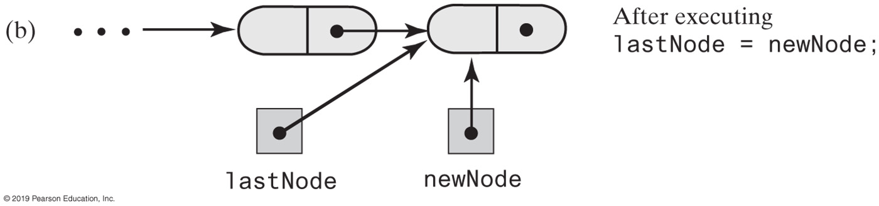
A Refined Linked Implementation
FIGURE 12-9 Adding a node to the end of a nonempty chain that has a tail reference

Slide 67
A Refined Linked Implementation
public void add(T newEntry)
{
Node newNode = new Node(newEntry);
if (isEmpty())
firstNode = newNode;
else
lastNode.setNextNode(newNode);
lastNode = newNode;
numberOfEntries++;
} // end add
Revision of the first add method

Slide 68
A Refined Linked Implementation - refined add by position
public void add(int givenPosition, T newEntry) {
if ((givenPosition >= 1) && (givenPosition <= numberOfEntries + 1))
{
Node newNode = new Node(newEntry);
if (isEmpty())
{
firstNode = newNode;
lastNode = newNode;
}
else if (givenPosition == 1)
{
newNode.setNextNode(firstNode);
firstNode = newNode;
}
else if (givenPosition == numberOfEntries + 1)
{
lastNode.setNextNode(newNode);
lastNode = newNode;
}
else {
Node nodeBefore = getNodeAt(givenPosition - 1);
Node nodeAfter = nodeBefore.getNextNode();
newNode.setNextNode(nodeAfter);
nodeBefore.setNextNode(newNode);
} // end if
numberOfEntries++;
}
else
throw new IndexOutOfBoundsException(
"Illegal position given to add operation.");
} // end add

Slide 69
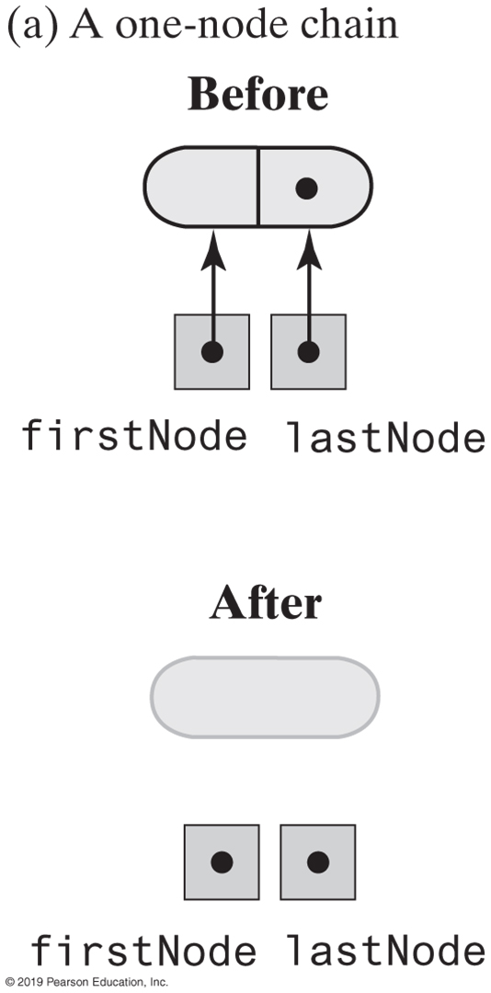
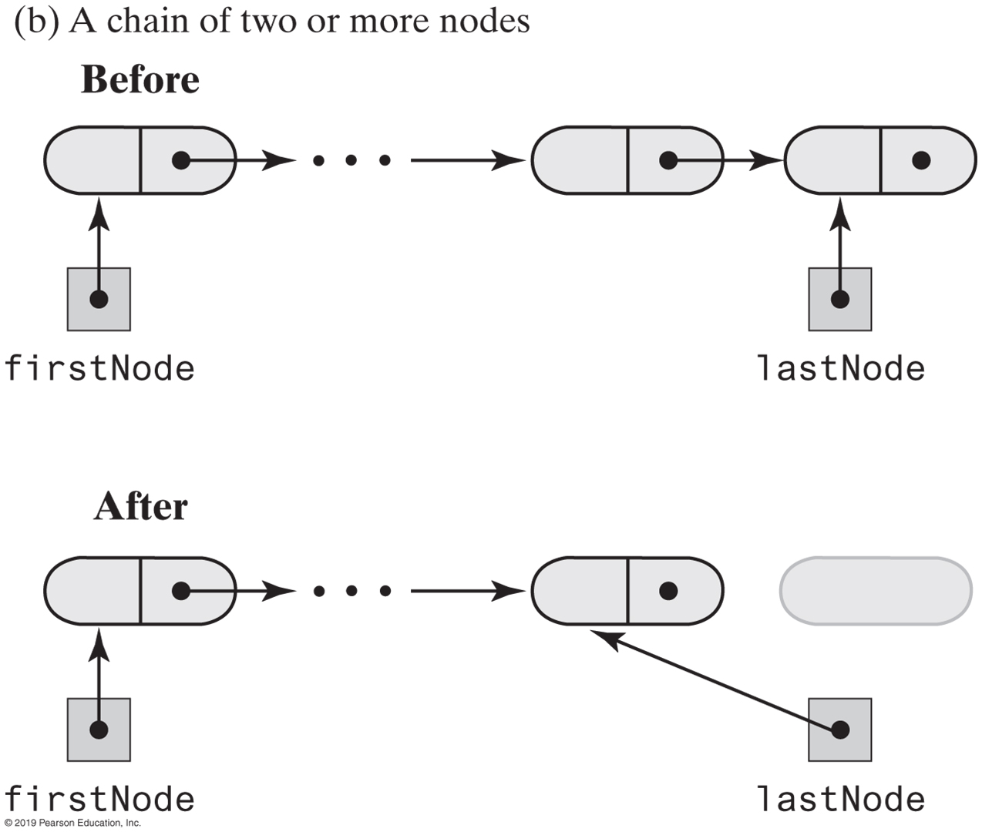
A Refined Linked Implementation
FIGURE 12-10 Before and after removing the last node from a chain that has both head and tail references and contains one or more nodes

Slide 70
A Refined Linked Implementation — refined remove
public T remove(int givenPosition) {
T result = null; // Return value
if ((givenPosition >= 1) && (givenPosition <= numberOfEntries))
{
// Assertion: !isEmpty()
if (givenPosition == 1) // Case 1: Remove first entry
{
result = firstNode.getData(); // Save entry to be removed
firstNode = firstNode.getNextNode();
if (numberOfEntries == 1)
lastNode = null; // Solitary entry was removed
}
else // Case 2: Not first entry
{
Node nodeBefore = getNodeAt(givenPosition - 1);
Node nodeToRemove = nodeBefore.getNextNode();
Node nodeAfter = nodeToRemove.getNextNode();
nodeBefore.setNextNode(nodeAfter);
result = nodeToRemove.getData();
if (givenPosition == numberOfEntries)
lastNode = nodeBefore; // Last node was removed
} // end if
numberOfEntries--;
}
else
throw new IndexOutOfBoundsException(
"Illegal position given to remove operation.");
return result; // Return removed entry
} // end remove

Slide 71
Efficiency of Using a Chain
Operation | Alist | LList | LListWithTail
add(newEntry) | O(1) | O(n) | O(1)
add(givenPosition, newEntry) | O(n); O(n); O(1) | O(1); O(n) | O(1); O(n); O(1)
toArray() | O(n) | O(n) | O(n)
remove(givenPosition) | O(n); O(n); O(1) | O(1); O(n) | O(1); O(n)
replace(givenPosition, newEntry) | O(1) | O(1); O(n) | O(1); O(n); O(1)
getEntry(givenPosition) | O(1) | O(1); O(n) | O(1); O(n); O(1)
contains(anEntry) | O(n) | O(n) | O(n)
clear(), getLength(), isEmpty() | O(1) | O(1) | O(1)
FIGURE 12-11 The time efficiencies of the ADT list operations for three implementations, expressed in Big Oh notation

Slide 72
Java Class Library: The Class LinkedList
Implements the interface List
LinkedList defines more methods than are in the interface List
You can use the class LinkedList as implementation of ADT
queue
deque
or list.

Slide 73
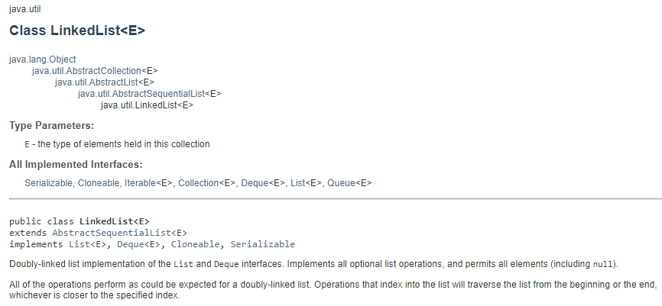
Java Class Library: The Class LinkedList

Slide 74
Specifications for ADT Sorted List
DATA
A collection of objects in sorted order and having the same data type
The number of objects in the collection
Operations requiring special consideration
add(newEntry)
remove(anEntry)
getPosition(anEntry)

Slide 75
Specifications for ADT Sorted List
Additional Operations
These behave as they do for the ADT List
getEntry(givenPosition)
contains(anEntry)
remove(givenPosition)
clear()
getLength()
isEmpty()
toArray()

Slide 76
Specifications for ADT Sorted List (Part 1)
/** An interface for the ADT sorted list.
Entries in the list have positions that begin with 1. */
public interface SortedListInterface<T extends Comparable<? super T>>
{
/** Adds a new entry to this sorted list in its proper order.
The list's size is increased by 1.
@param newEntry The object to be added as a new entry. */
public void add(T newEntry);
/** Removes the first or only occurrence of a specified entry
from this sorted list.
@param anEntry The object to be removed.
@return True if anEntry was located and removed;
otherwise returns false. */
public boolean remove(T anEntry);
/** Gets the position of an entry in this sorted list.
@param anEntry The object to be found.
@return The position of the first or only occurrence of anEntry
if it occurs in the list; otherwise returns the position
where anEntry would occur in the list, but as a negative
integer. */
public int getPosition(T anEntry);
LISTING 17-1 The interface SortedListInterface

Slide 77
Specifications for ADT Sorted List (Part 2)
// The following methods are described in Segment 10.9 of Chapter 10
// as part of the ADT list:
public T getEntry(int givenPosition);
public boolean contains(T anEntry);
public T remove(int givenPosition);
public void clear();
public int getLength();
public boolean isEmpty();
public T[] toArray();
} // end SortedListInterface
LISTING 17-1 The interface SortedListInterface

Slide 78
Linked Sorted List Implementation
/** A class that implements the ADT sorted list by using a chain of linked nodes.
Duplicate entries are allowed. */
public class LinkedSortedList<T extends Comparable<? super T>>
implements SortedListInterface<T>
{
private Node firstNode; // Reference to first node of chain
private int numberOfEntries;
public LinkedSortedList()
{
firstNode = null;
numberOfEntries = 0;
} // end default constructor
/* < Implementations of the sorted list operations go here.>
. . . */
private class Node
{
/* < Implementations of the Node operations go here.>
} // end Node
} // end LinkedSortedList
LISTING 17-2 An outline of a linked implementation of the ADT sorted list

Slide 79
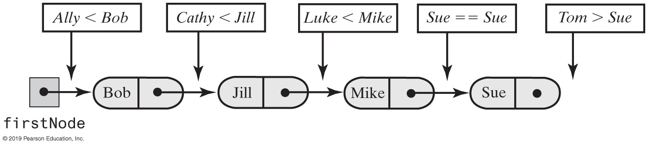
Linked Sorted List Implementation
FIGURE 17-1 Places to insert additional names into a sorted chain of linked nodes

Slide 80
Linked Sorted List Implementation
Algorithm add(newEntry)
// Adds a new entry to the sorted list.
Allocate a new node containing newEntry
Search the chain until either you find a node containing newEntry or you pass the point where it should be
Let nodeBefore reference the node before the insertion point
if (the chain is empty or the new node belongs at the beginning of the chain)
Add the new node to the beginning of the chain
else
Insert the new node after the node referenced by nodeBefore
Increment the length of the sorted list
Algorithm for add method.

Slide 81
Linked Sorted List Implementation
public void add(T newEntry)
{
Node newNode = new Node(newEntry);
Node nodeBefore = getNodeBefore(newEntry);
if (isEmpty() || (nodeBefore == null))
{
// Add at beginning
newNode.setNextNode(firstNode);
firstNode = newNode;
}
else
{
// Add after nodeBefore
Node nodeAfter = nodeBefore.getNextNode();
newNode.setNextNode(nodeAfter);
nodeBefore.setNextNode(newNode);
} // end if
numberOfEntries++;
} // end add
An iterative implementation of add

Slide 82
Linked Sorted List Implementation
// Finds the node that is before the node that should or does
// contain a given entry.
// Returns either a reference to the node that is before the node
// that contains--or should contain--anEntry,
// or null if no prior node exists
// (that is, if anEntry is or belongs at the beginning of the list).
private Node getNodeBefore(T anEntry)
{
Node currentNode = firstNode;
Node nodeBefore = null;
while ( (currentNode != null) &&
(anEntry.compareTo(currentNode.getData()) > 0) )
{
nodeBefore = currentNode;
currentNode = currentNode.getNextNode();
} // end while
return nodeBefore;
} // end getNodeBefore
The private method getNodeBefore

Slide 83
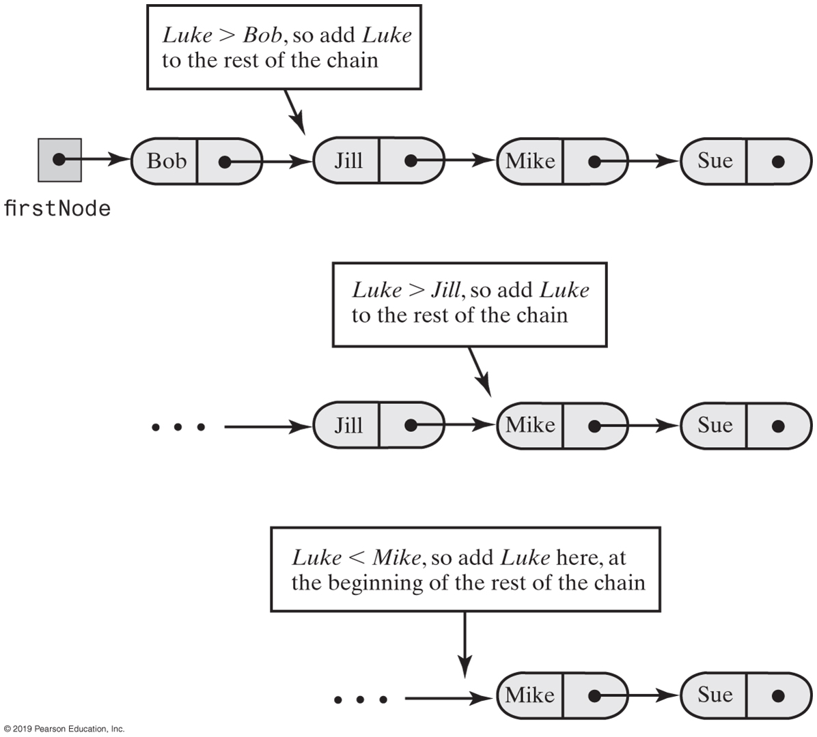
Recursive Add to Sorted List
FIGURE 17-2 Recursively adding Luke to a sorted chain of names

Slide 84

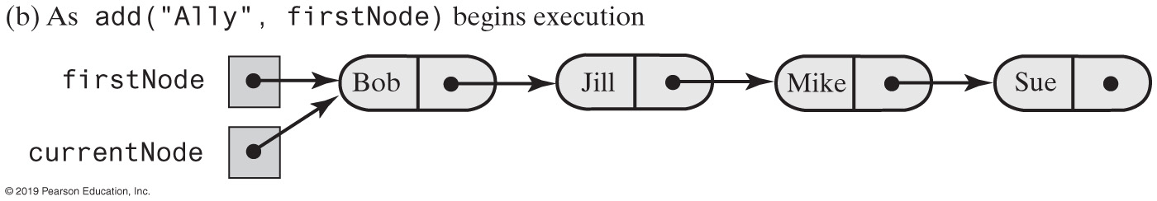
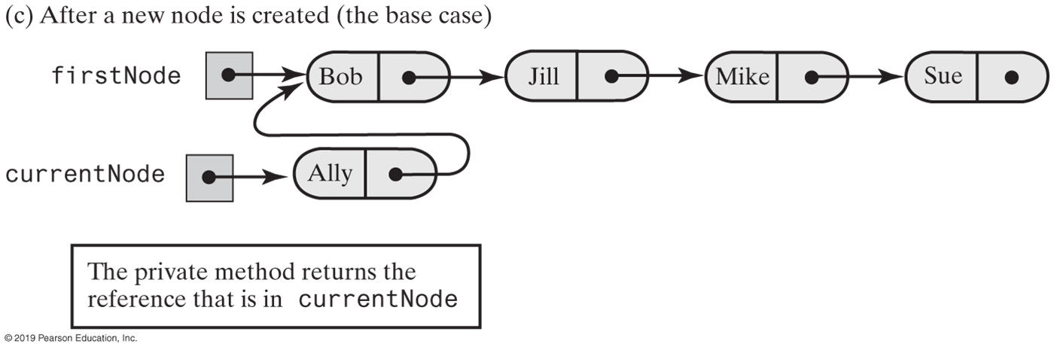
Recursive Add to Sorted List (Part 1)
FIGURE 17-3 Recursively adding a node at the beginning of a chain

Slide 85
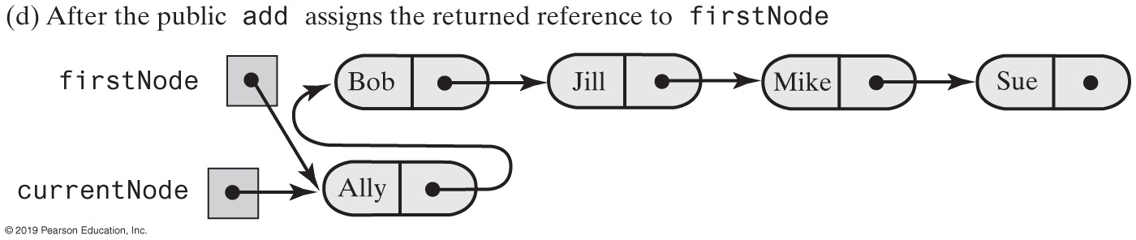
Recursive Add to Sorted List (Part 2)
[from previous slide]
FIGURE 17-3 Recursively adding a node at the beginning of a chain

Slide 86
Linked Sorted List Implementation
public void add(T newEntry)
{
firstNode = add(newEntry, firstNode);
numberOfEntries++;
} // end add
private Node add(T newEntry, Node currentNode)
{
if ( (currentNode == null) ||
(newEntry.compareTo(currentNode.getData()) <= 0) )
{
currentNode = new Node(newEntry, currentNode);
}
else
{
Node nodeAfter = add(newEntry, currentNode.getNextNode());
currentNode.setNextNode(nodeAfter);
} // end if
return currentNode;
} // end add
A recursive implementation of add

Slide 87
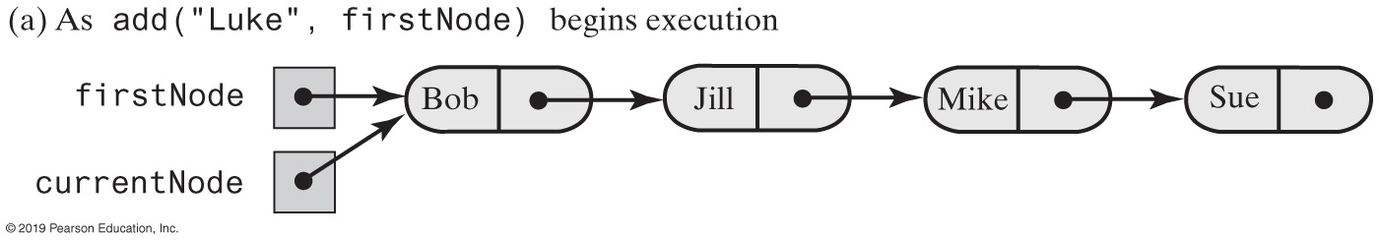
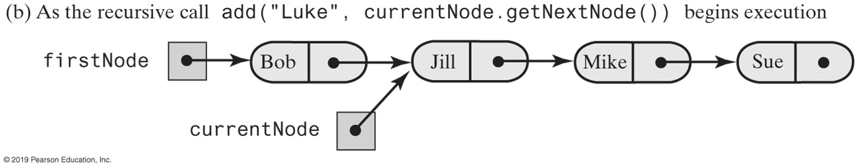
Recursive Add to Sorted List (Part 1)
FIGURE 17-4 Recursively adding a node between existing nodes in a chain

Slide 88
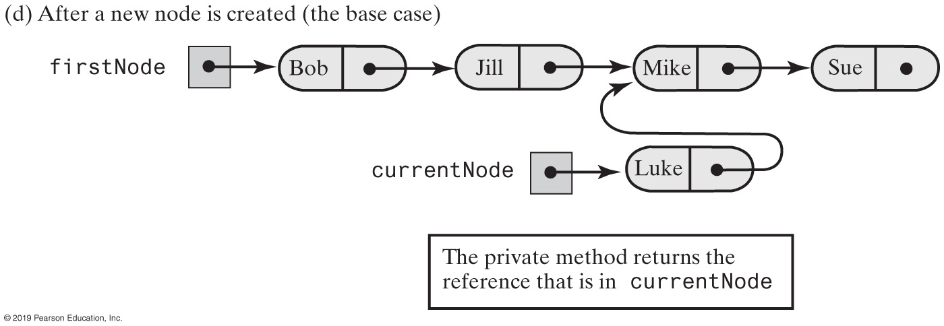
Recursive Add to Sorted List (Part 2)
[from previous slide]
FIGURE 17-4 Recursively adding a node between existing nodes in a chain

Slide 89
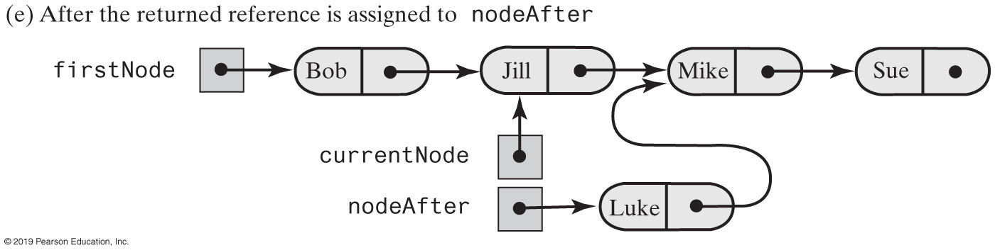
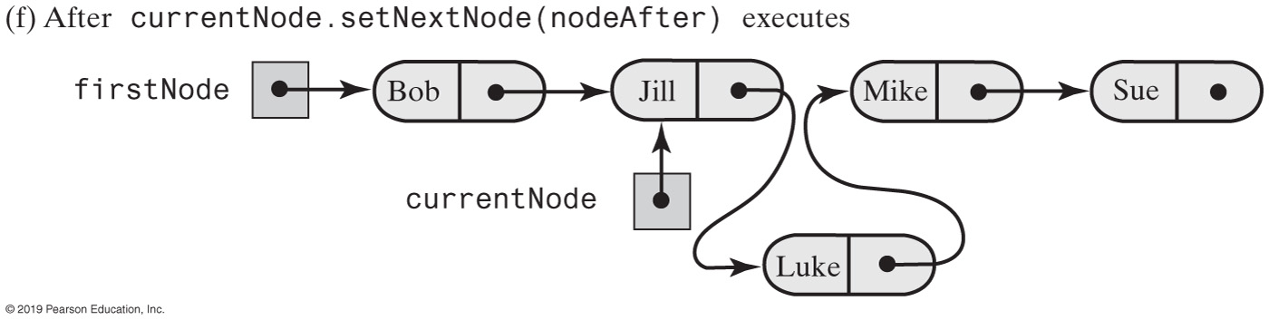
Recursive Add to Sorted List (Part 2)
[from previous slide]
FIGURE 17-4 Recursively adding a node between existing nodes in a chain

Slide 90
Comparison of Implementations
Operation | Array | Linked
add(newEntry) | O(n) | O(n)
remove(anEntry) | O(n) | O(n)
getPosition(anEntry) | O(n) | O(n)
getEntry(givenPosition) | O(1) | O(n)
contains(anEntry) | O(n) | O(n)
remove(givenPosition) | O(n) | O(n)
display() | O(n) | O(n)
clear(), getLength(), isEmpty() | O(1) | O(1)
FIGURE 17-5 The worst-case efficiencies of the operations on the ADT sorted list for two implementations

Slide 91
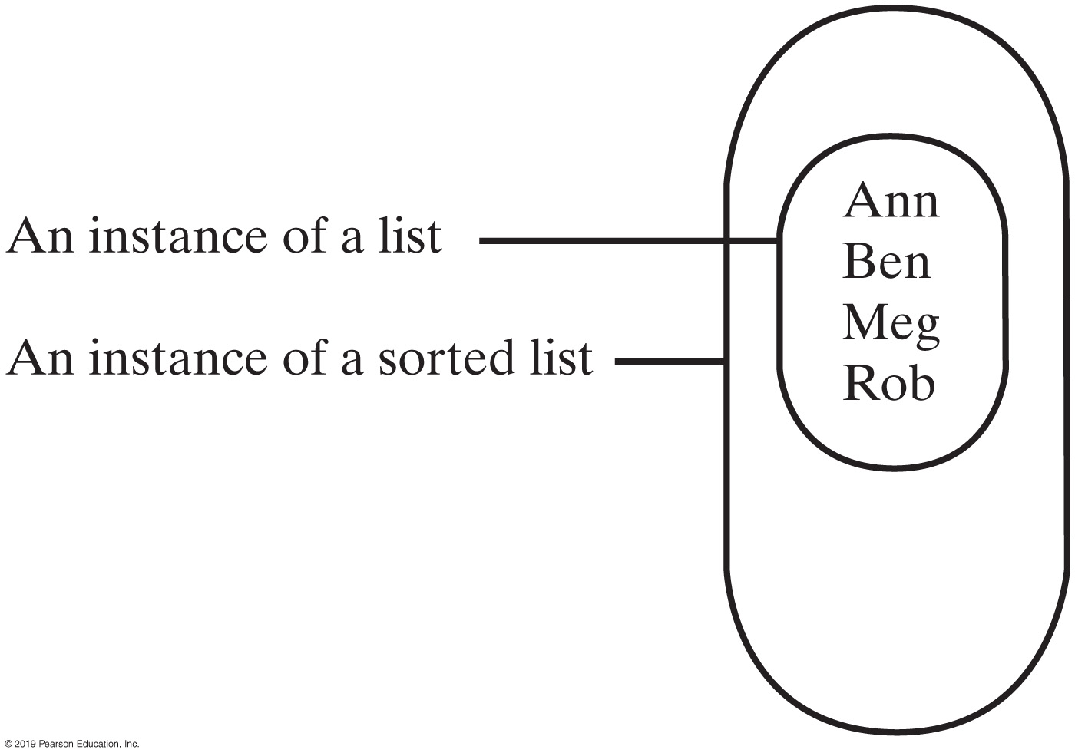
Implementation that uses ADT List
FIGURE 17-6 An instance of a sorted list that contains a list of its entries

Slide 92
Implementation That Uses the ADT List
/** A class that implements the ADT sorted list by
using an instance of LList. */
public class SortedList<T extends Comparable<? super T>>
implements SortedListInterface<T>
{
private ListInterface<T> list;
public SortedList()
{
list = new LList<T>();
} // end default constructor
// . . .
} // end SortedList
Our class SortedList will implement the interface SortedListInterface

Slide 93
Implementation That Uses the ADT List
public void add(T newEntry)
{
int newPosition = Math.abs(getPosition(newEntry));
list.add(newPosition, newEntry);
} // end add
The method add.

Slide 94
Implementation That Uses the ADT List
public boolean remove(T anEntry)
{
boolean result = false;
int position = getPosition(anEntry);
if (position > 0)
{
list.remove(position);
result = true;
} // end if
return result;
} // end remove
The method remove.

Slide 95
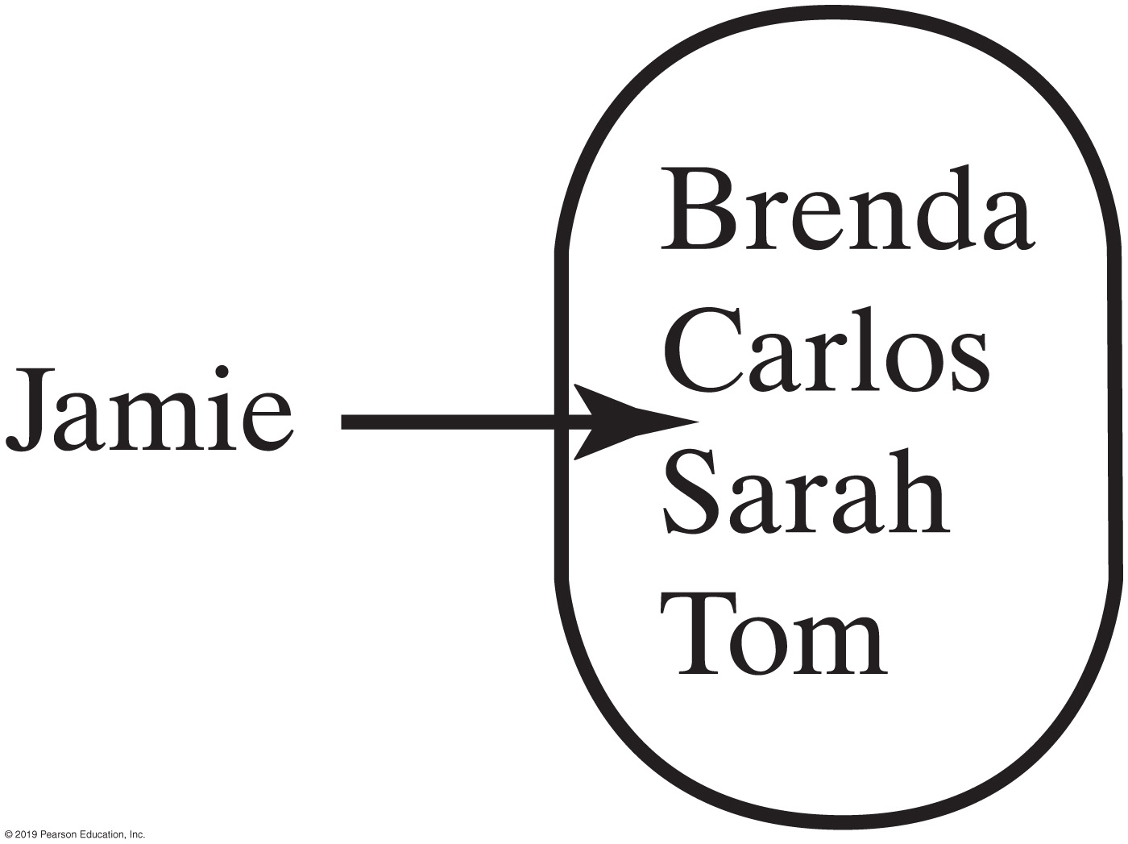
Implementation That Uses the ADT List
FIGURE 17-7 A sorted list in which Jamie belongs after Carlos but before Sarah

Slide 96
Implementation That Uses the ADT List
public int getPosition(T anEntry)
{
int position = 1;
int length = list.getLength();
// Find position of anEntry
while ( (position <= length) &&
(anEntry.compareTo(list.getEntry(position)) > 0) )
{
position++;
} // end while
// See whether anEntry is in list
if ( (position > length) ||
(anEntry.compareTo(list.getEntry(position)) != 0) )
{
position = -position; // anEntry is not in list
} // end if
return position;
} // end getPosition
The implementation of getPosition

Slide 97
Comparison of Implementations
Operation | Array | Linked
add(newEntry) | O(n) | O(n)
remove(anEntry) | O(n) | O(n)
getPosition(anEntry) | O(n) | O(n)
getEntry(givenPosition) | O(1) | O(n)
contains(anEntry) | O(n) | O(n)
remove(givenPosition) | O(n) | O(n)
display() | O(n) | O(n)
clear(), getLength(), isEmpty() | O(1) | O(1)
FIGURE 17-8 The worst-case efficiencies of the operations on the ADT sorted list for two implementations

Slide 98
Comparison of Implementations
Operation | Array | Linked | ArraryList | LList
add(newEntry) | O(n) | O(n) | O(n) | O(n²)
remove(anEntry) | O(n) | O(n) | O(n) | O(n²)
getPosition(anEntry) | O(n) | O(n) | O(n) | O(n²)
getEntry(givenPosition) | O(1) | O(n) | O(1) | O(n)
contains(anEntry) | O(n) | O(n) | O(n) | O(n)
remove(givenPosition) | O(n) | O(n) | O(n) | O(n)
display() | O(n) | O(n) | O(n) | O(n)
clear(), getLength(), isEmpty() | O(1) | O(1) | O(1) | O(1)
FIGURE 17-9 The worst-case efficiencies of the ADT sorted list operations when implemented using an instance of the ADT list

Slide 99
Inheritance to Implement a Sorted List
/** A class that implements the ADT sorted list by extending LList.
Duplicate entries are allowed. */
public class SortedList<T extends Comparable<? super T>>
extends LList<T> implements SortedListInterface<T>
{
public void add(T newEntry)
{
int newPosition = Math.abs(getPosition(newEntry));
super.add(newPosition, newEntry);
} // end add
/* < Implementations of remove(anEntry) and getPosition(anEntry) go here. >
. . . */
} // end SortedList
If SortedList inherited methods from LList, we would not have to implement them again.

Slide 100
Inheritance to Implement a Sorted List
/** Adds newEntry to the list at position newPosition. */
public void add(int newPosition, T newEntry);
/** Replaces the entry at givenPosition with newEntry. */
public T replace(int givenPosition, T newEntry);
Although SortedList conveniently inherits methods such as isEmpty from LList, it also inherits two methods that a client can use to destroy the order of a sorted list.

Slide 101
Inheritance to Implement a Sorted List
Possible ways to avoid the pitfall
Use SortedListInterface in the declaration of the sorted list.
Implement the list’s add and replace methods within the class SortedList
Implement the list’s add and replace methods within the class SortedList and have them throw an exception when invoked

Slide 102
Designing a Base Class (Part 1)
/** A class that implements the ADT list by using a chain of
linked nodes that has a head reference. */
public class LList<T> implements ListInterface<T>
{
private Node firstNode; // Reference to first node
private int numberOfEntries;
public LList()
{
initializeDataFields();
} // end default constructor
public int clear()
{
initializeDataFields();
} // end clear
/* < Implementations of the public methods add, remove,
replace, getEntry, contains,
getLength, isEmpty, and toArray go here. >
. . . */
LISTING 18-1 Relevant aspects of the class LList

Slide 103
Designing a Base Class (Part 2)
// Initializes the class’s data fields to indicate an empty list.
private void initializeDataFields()
{
firstNode = null;
numberOfEntries = 0;
} // end initializeDataFields
// Returns a reference to the node at a given position.
private Node getNodeAt(int givenPosition)
{
// . . .
} // end getNodeAt
private class Node
{
private T data;
private Node next;
// . . .
} // end Node
} // end LList
LISTING 18-1 Relevant aspects of the class LList

Slide 104
Designing a Base Class
LList
Private data fields: firstNode numberOfEntries Private methods: initializeDataFields getNodeAt Private inner class: Node
Any subclass (derived class)
Cannot access or change firstNode Cannot change numberOfEntries Cannot invoke initializeDataFields Cannot invoke getNodeAt Cannot create an instance of Node Cannot access or change ﬁelds of an existing node
FIGURE 18-1 A derived class of the class LList cannot access or change anything that is private within LList

Slide 105
Designing a Base Class
protected final Node getFirstNode()
{
return firstNode;
} // end getFirstNode
Protected method getFirstNode, enabling the subclass to access the head reference firstNode

Slide 106
Designing a Base Class
/** Adds a node to the beginning of a chain. */
protected final void addFirstNode(Node theNode)
/** Adds a node to a chain after a given node. */
protected final void addAfterNode(Node nodeBefore, Node theNode)
/** Removes a chain’s first node. */
protected final T removeFirstNode()
/** Removes the node after a given one. */
protected final T removeAfterNode(Node nodeBefore)
Protected methods to add and remove nodes, changing firstNode and numberOfEntries as necessary

Slide 107
Designing a Base Class
/** Adds a node to the beginning of a chain. */
protected final void addFirstNode(Node theNode)
{
// Assertion: theNode != null
theNode.setNextNode(firstNode);
firstNode = theNode;
numberOfEntries++;
} // end addFirstNode
Definition of addFirstNode.

Slide 108
Designing a Base Class
public T remove(int givenPosition)
{
T result = null;
if ((givenPosition >= 1) && (givenPosition <= getLength()))
{
// Assertion: The list is not empty
if (givenPosition == 1) // Case 1: Remove first entry
result = removeFirstNode();
else // Case 2: givenPosition > 1
{
Node nodeBefore = getNodeAt(givenPosition - 1);
result = removeAfterNode(nodeBefore);
} // end if
return result; // Return removed entry
}
else
throw new IndexOutOfBoundsException(
“Illegal position given to remove operation.");
} // end remove
Revision of LList’s method remove

Slide 109
Designing a Base Class
protected final T getData()
protected final void setData(T newData)
protected final Node getNextNode()
private final void setNextNode(Node nextNode)
Node has these four methods.

Slide 110
Designing a Base Class
LListRevised
Private data fields: firstNode numberOfEntries
Protected, final methods: getFirstNode addFirstNode addAfterNode removeFirstNode removeAfterNode getNodeAt initializeDataFields Protected, final inner class: Node (Has protected methods getData, setData, and getNextNode and private method setNextNode)
FIGURE 18-2 Access available to a class derived from the class LListRevised
Any subclass (derived class)
Can access firstNode and numberOfEntries Can invoke the protected methods Can create an instance of Node Can access the ﬁelds of an existing node Can change the data in an existing node Cannot override Node and the ﬁnal methods

Slide 111
Designing a Base Class
LinkedChainBase
Private data fields: firstNode numberOfEntries
Public methods: clear getLength isEmpty toArray Protected, final methods: getFirstNode addFirstNode addAfterNode removeFirstNode removeAfterNode getNodeAt initializeDataFields Protected, final inner class: Node (Has protected methods getData, setData, and getNextNode and private method setNextNode)
FIGURE 18-3 The separation of linked-chain operations and list operations
LinkedChainList
Public methods: add remove replace getEntry contains

Slide 112
Creating an Abstract Base Class
/** An abstract base class for use in implementing the ADT list
by using a chain of nodes. All methods are implemented, but
since the class is abstract, no instances can be created. */
public abstract class LinkedChainBase<T>
{
private Node firstNode; // Reference to first node
private int numberOfEntries;
public LinkedChainBase()
{
initializeDataFields();
} // end default constructor
/* < Implementations of the public methods clear, getLength, isEmpty, and toArray go here. >
. . .
< Implementations of the protected, final methods getFirstNode, addFirstNode,
addAfterNode, removeFirstNode, removeAfterNode, getNodeAt, and
initializeDataFields go here. >
protected final class Node
{
/* < Implementations of the protected methods getData, setData, and getNextNode go here. >
< Implementation of the private method setNextNode goes here. > . . . */
} // end Node
} // end LinkedChainBase
LISTING 18-2 The abstract base class LinkedChainBase

Slide 113
Efficient Implementation of a Sorted List
public class LinkedChainSortedList<T extends Comparable<? super T>>
extends LinkedChainBase<T>
implements SortedListInterface<T>
We want our class to extend LinkedChainBase

Slide 114
Efficient Implementation of a Sorted List
public void add(T newEntry)
{
Node theNode = new Node(newEntry);
Node nodeBefore = getNodeBefore(newEntry);
if (nodeBefore == null) // No need to call isEmpty
addFirstNode(theNode);
else
addAfterNode(nodeBefore, theNode);
} // end add
Details of a previous add method now hidden within the protected methods addFirstNode and addAfterNode of LinkedChainBase

Slide 115
Efficient Implementation of a Sorted List
private Node getNodeBefore(T anEntry)
{
Node currentNode = getFirstNode();
Node nodeBefore = null;
while ((currentNode != null) &&
(anEntry.compareTo(currentNode.getData()) > 0))
{
nodeBefore = currentNode;
currentNode = currentNode.getNextNode();
} // end while
return nodeBefore;
} // end getNodeBefore
The private method getNodeBefore

